Slide 1
INSTRUCTIONS
REVIEW THE SLIDE DECK AND UPDATE ALL SLIDES WITH RED FONT.
ONCE UPDATED CHANGE RED FONT COLOR TO BLACK OR WHITE FONT.
LOCATE YOUR SCHOOL PERFORMANCE DATA, THEN SCAN AND INSERT INTO SLIDE AS AN IMAGE.
WHEN UPDATING THE DOLLAR AMOUNT FOR THE TITLE I BUDGET INCLUDE THE TOTAL OF:
* TITLE I
* TITLE I PARENT AMOUNT
SUMMARIZE (BRIEFLY) A STRATEGY OR TWO FOR EACH GOAL
AFTER STEPS
1-5 ARE
COMPLETE – DELETE THIS SLIDE!
Stockton Unified School District

Slide 2
Stockton Unified School District
2022-2023
Title I
Parent Meeting
Agenda
* What is Title I? / Goals of Title I / Parents Rights
* School Plan for Student Achievement (SPSA)
* Title I Funding
* Title I Parental & Family Engagement Policy
* School-Parent Compact
[INSERT SCHOOL NAME, CHANGE FONT TO WHITE]
[INSERT DATE OF MEETING, CHANGE FONT TO WHITE]

Slide 3
Stockton Unified School District
WHAT IS TITLE I?
Title I provides additional academic support and learning opportunities for students.
The program is intended to help ensure that all students meet the California Common Core State Standards.
Parents Rights…
* Ask for meetings and trainings
* Review the school’s achievement data
* Review the parent involvement plan and activities included in the School Plan for Student Achievement
* Review and modify the school’s Title I Parental & Family Engagement Policy and School-Parent Compact
GOALS OF TITLE I
Increase academic achievement
Provide direct instructional support to students
Provide professional development to teachers
Promote parent education and involvement

Slide 4
At our school, parents are involved in the following activities at our site:
Parent conferences
Workshops/training
Coffee Hour
PTO/PTA
Volunteer work
PARENT INVOLVEMENT
The School Site Council (SSC) provides parents with an opportunity to be involved in the academic program of the school.
The SSC develops, monitors, and evaluates the School Plan for Student Achievement to implement programs and services that support students.
Collaboration (working together) between schools and families is essential to increase student achievement.
Be Informed… we are using the following to communicate with you!
Mass Notification System
Website
PeachJar
Facebook
Twitter
Class notification app
Stockton Unified School District

Slide 5
SCHOOL PLAN FOR STUDENT ACHIEVEMENT
SPSA Development –
FOUR Required Actions:
1) The SPSA must be meaningfully developed with parent input.
2) The SPSA must be shared with ELAC, with opportunity for ELAC recommendations.
3) The SPSA must be approved by the School Site Council, after ELAC recommendations are presented and considered.
4) The SPSA must be approved by the district’s governing board.
Annually evaluate the program goals
Comprehensive Needs Assessment
Review of School Performance Data (Dashboard, Comprehensive School Profile, etc.)
Goals and strategies to address student academic needs
Description of core and supplemental programs
Description of instructional strategies and interventions to assist struggling students
Professional needs and activities
Parent involvement strategies and activities
Alignment of Fiscal Resources with strategies
Available electronically: https://www.stocktonusd.net/Page/10028
Stockton Unified School District

Slide 6
DISTRICT CURRICULUM
(adopted January 2019)
Benchmark Advance (ELA/ELD)
Ready Math
Pearson Math (Algebra/Geometry)
MyPerspectives (ELA/ELD)
SCHOOL PERFORMANCE DATA
Schools analyze the SBAC, ELPAC, and iReady assessment results and review school-wide performance data
Schools adjust instructional practices based on the findings of the performance data.
The performance data is used to align the curriculum to the state standards to improve instruction.
SBAC - Smarter Balanced Assessment Consortium
ELPAC - English Language Proficiency Assessments for California

Slide 7
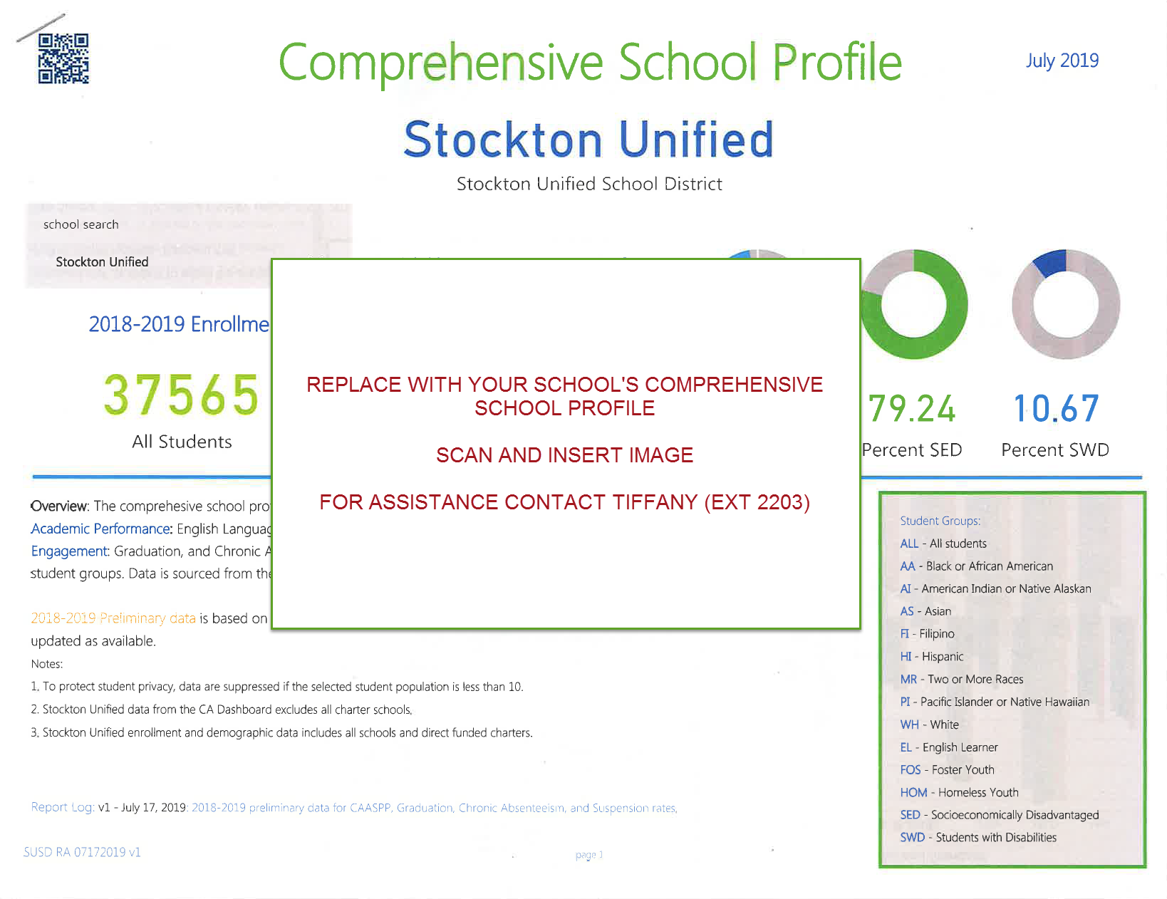
SCHOOL PERFORMANCE DATA
Remove this direction box:
Locate the school performance data and add additional slides as necessary.
Stockton Unified School District

Slide 8
TITLE I FUNDING ALLOCATION
Schools are allocated funds based upon the percentage of students receiving free or reduced lunch.
Schools are ranked according to this percentage and receive a per pupil allocation.
One percent of the school’s total Title I budget is for parent involvement activities.
Total Title I Allocation:
$[Total of Title I AND Title I Parent funds]
Stockton Unified School District

Slide 9
SPSA SCHOOL STRATEGIES
Our SPSA includes strategies/activities as a Schoolwide Program:
Goal 1 - Student Achievement
Identify and briefly describe strategies/activities, such as tutoring, intervention programs, professional development supporting instructional strategies, etc.
Goal 2 – Safe and Healthy Learning Environments
Identify and briefly describe strategies/activities that promote consistent attendance, reduce suspensions, school connectedness, etc.
Goal 3 – Meaningful Partnerships
Identify and briefly describe strategies/activities that support making connections with parents through workshops and training on subjects identified by parents, training parents on instructional strategies to replicate at home, etc.
Remove this direction box:
Add additional slides if necessary.
Stockton Unified School District

Slide 10
Parent and Family Engagement Policy
Every Title I school, in collaboration with parents, must prepare a site-level parental and family engagement policy.
The Policy describes how the school will involve parents in a meaningful, ongoing, and timely way.
The Policy also describes how parents will be involved in the planning, review, and improvement of the school’s Title I program and activities.
School – Parent Compact
The Compact describes how the school and parents share the responsibility for student achievement
It is developed in collaboration among parents, teachers, and students.
The Compact is distributed annually with the Title I Parent and Family Engagement Policy
PARENT AND FAMILY ENGAGEMENT POLICY
and
SCHOOL – PARENT COMPACT
Stockton Unified School District

Slide 11
QUESTIONS?
[INSERT NAME OF PRINCIPAL]
[INSERT CONTACT NUMBER]
[INSERT SCHOOL WEBSITE]
Stockton Unified School District

